Slide 1
Lab 2: Sensors

Slide 2
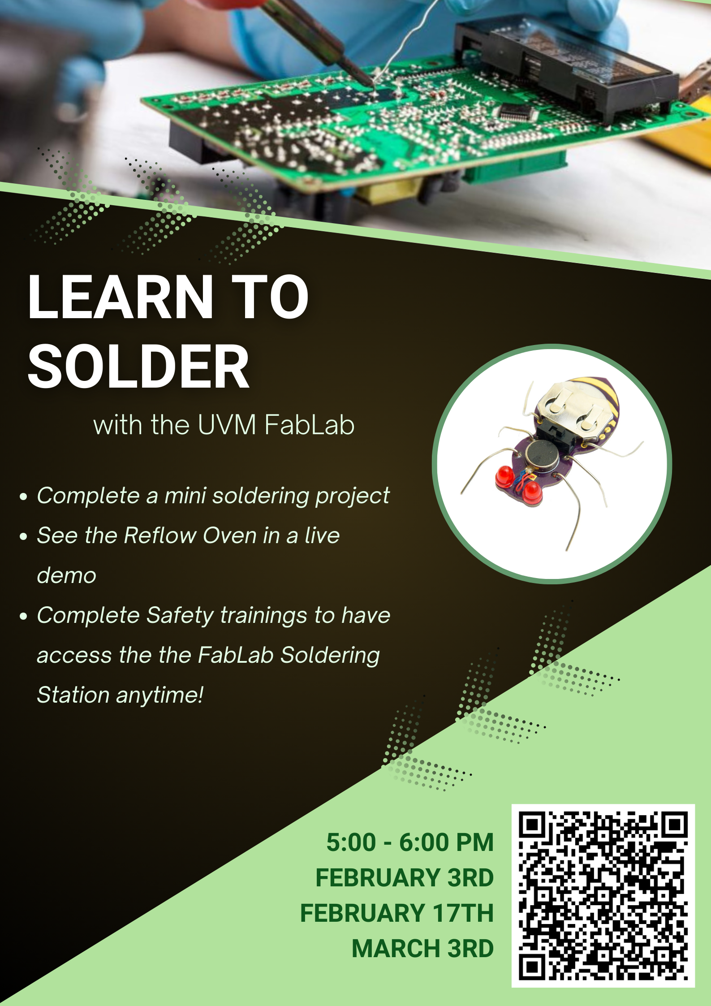

Soldering stuff yay
Or learn with Ian or Jack

Slide 3
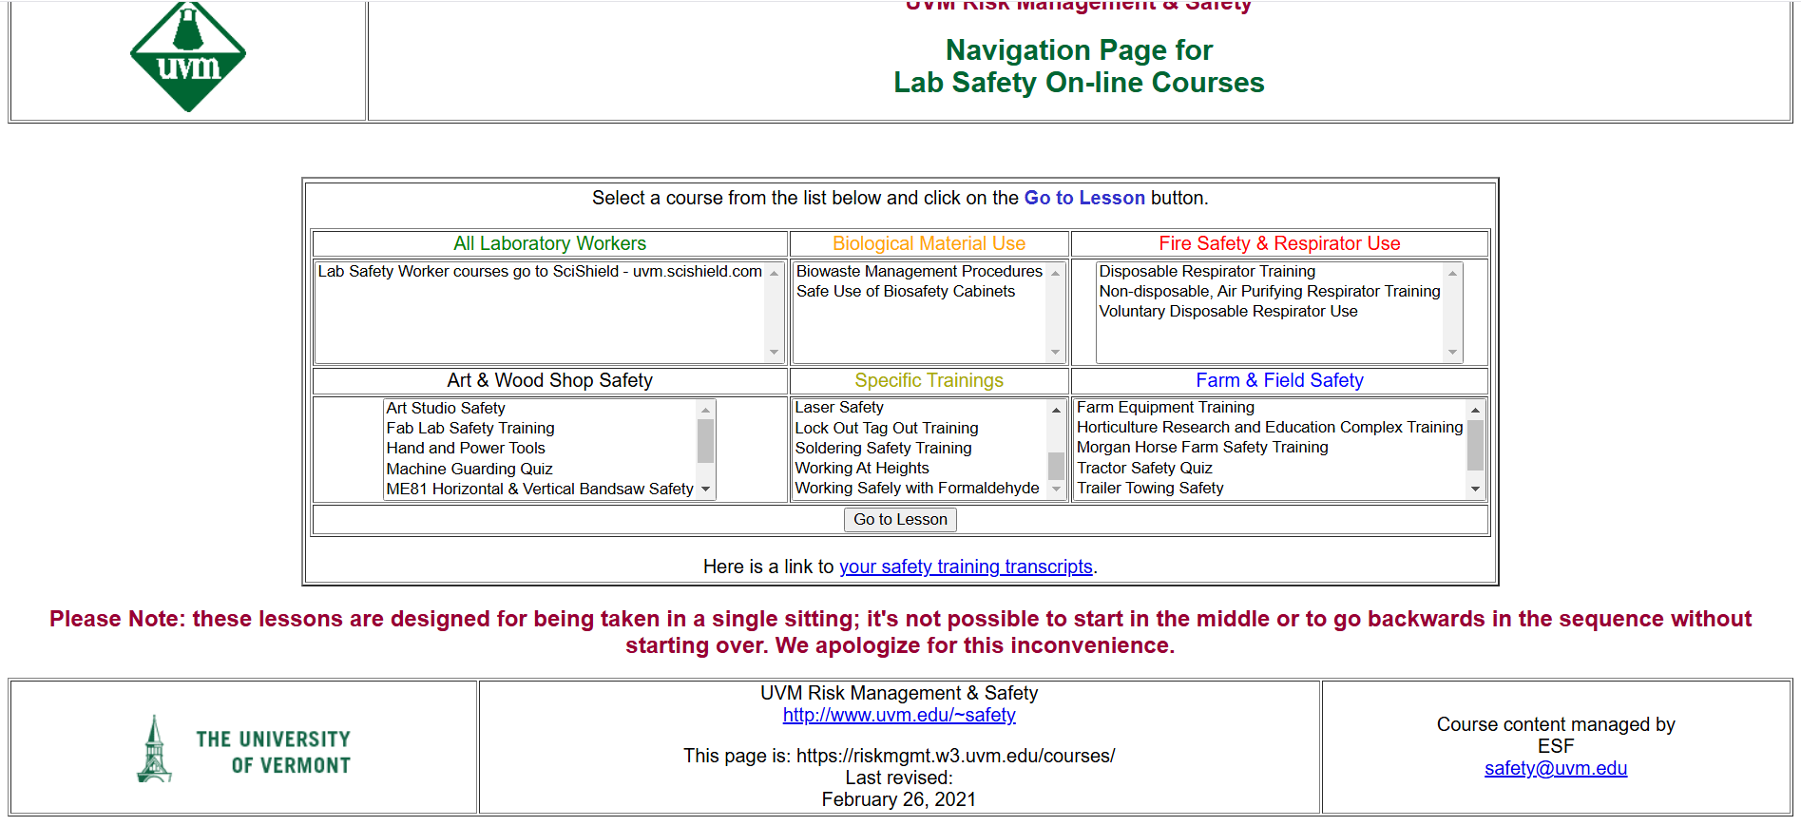

The site! Link
Source: Spring 2025 TAs Jack McTasney and Ian Cassidy

Slide 4
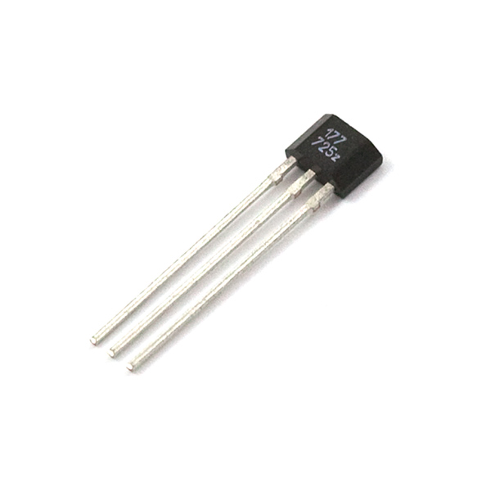
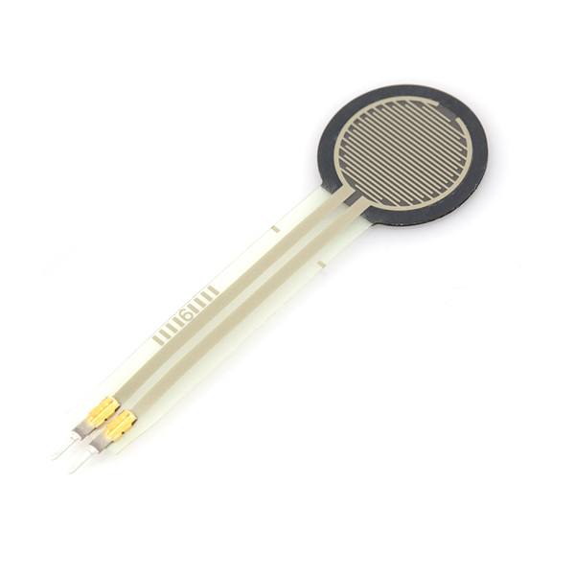
Sensors
Sensors are devices that create or change an electric signal proportional to a change in the environment surrounding them or a change in the device itself, caused by exterior action or influence.
Examples:
Thermistor: a device that changes its resistance based on the surrounding temperature
Photocell: a device that changes its resistance based on the light intensity
Force sensor: a device that changes its resistance depends on the force applying on it.
Hall effect sensor: a devices that’s output voltage changes based on the strength of the magnetic field around it.
Source: Dr. Eva Cosoroaba, Ph.D. EE100 lab 2 manual, Fall 2018, Sparkfun, Khang Tran EE 001 – Lab 2 Spring 2019

Slide 5
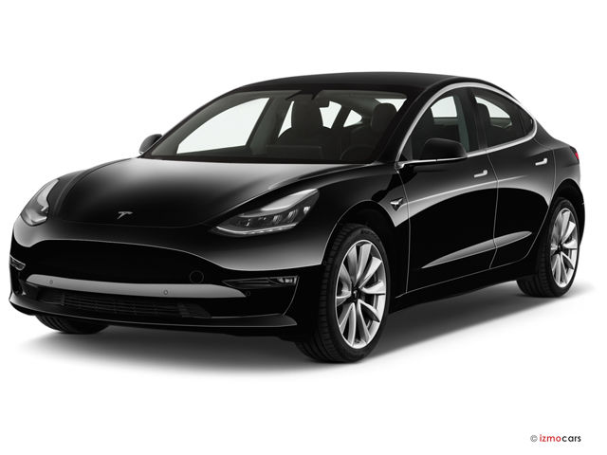
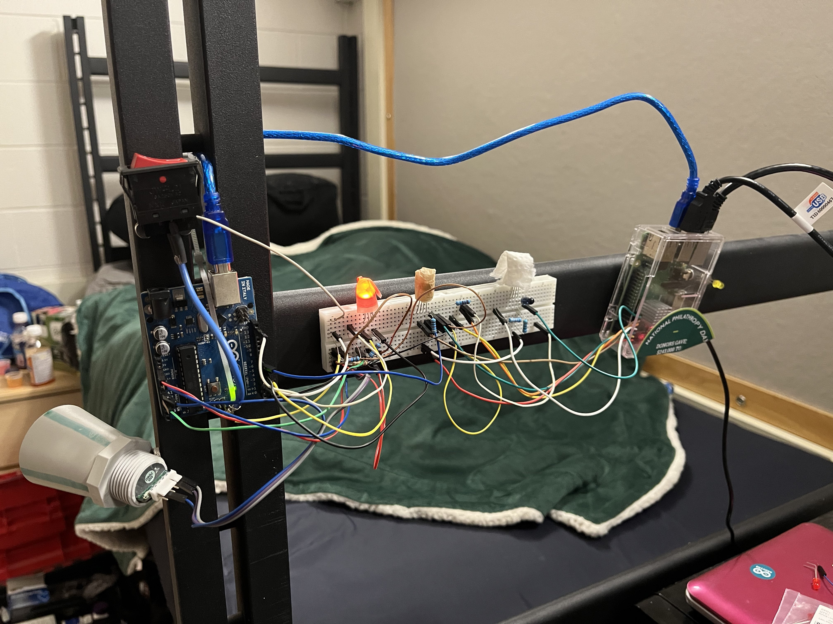
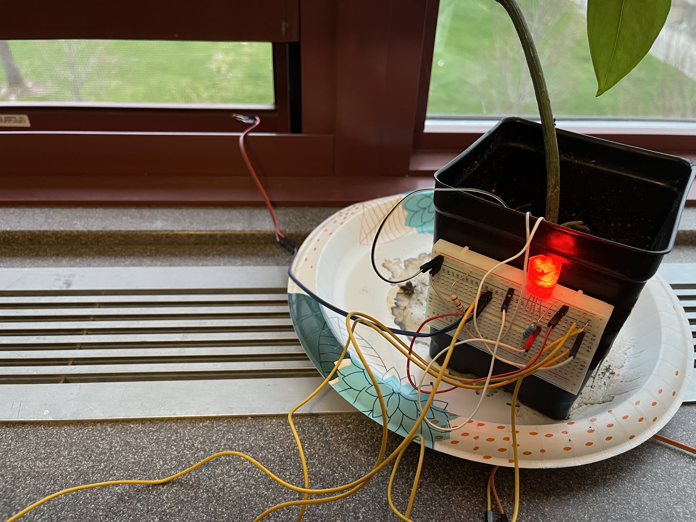
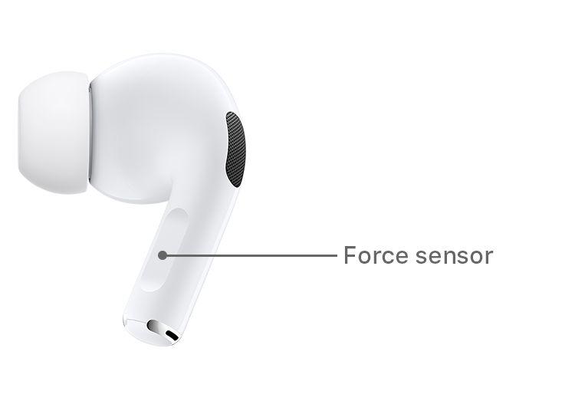
Sensor Examples:
Soil moisture sensor
Thermistor
Thermistor
(Somewhere)
Ultrasonic
I-Dorm V1 2022
Source: HowStuffWorks, Apple, Tesla, EE-1100 TA Jack McTasney 2024

Slide 6
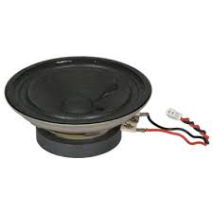
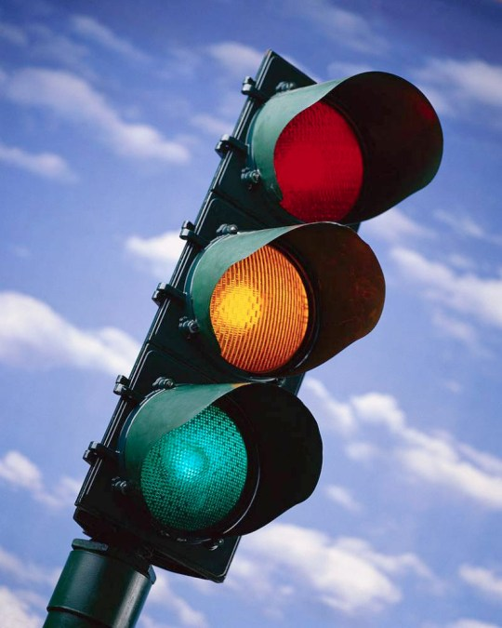
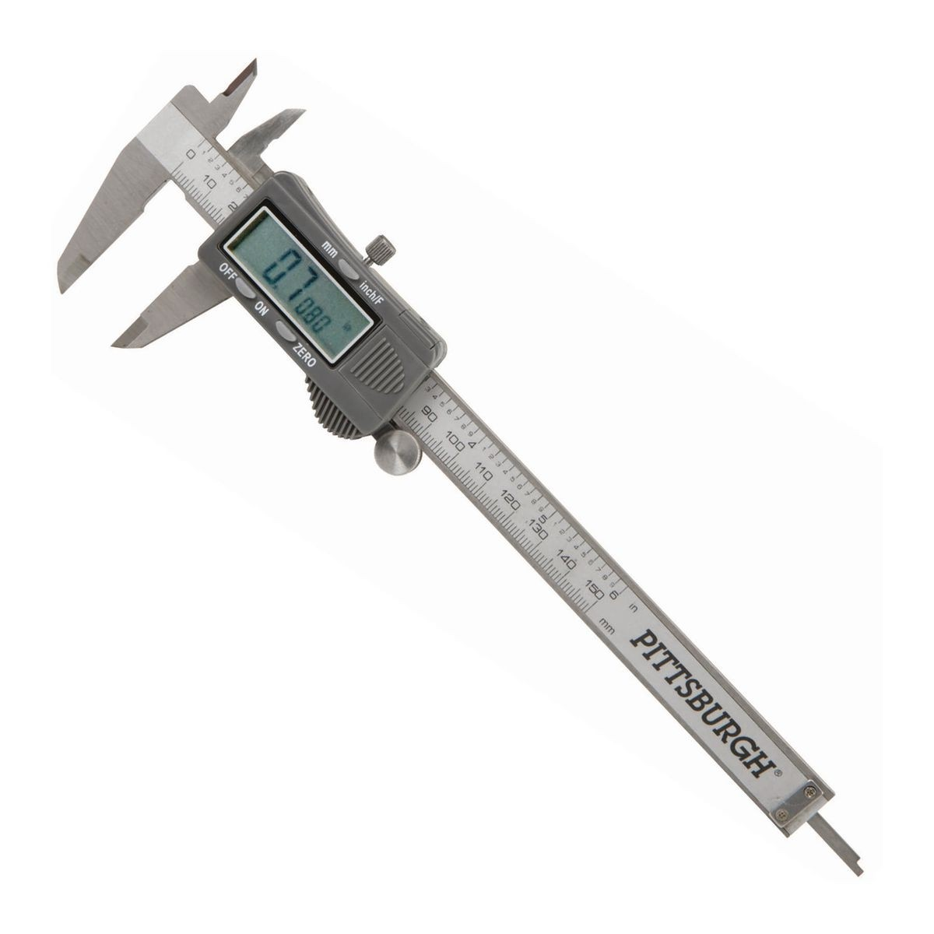
Indicators
Indicators are devices used to show the current state or level and changes to that state or level of something. For example we have used LEDs as indicators others include sound and digital displays.
Source: Jameco, Harbor Freight and Alamy

Slide 7
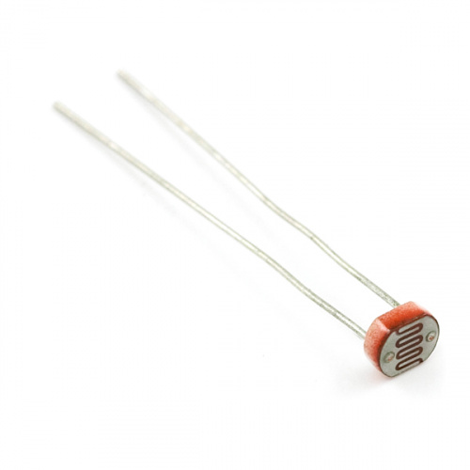
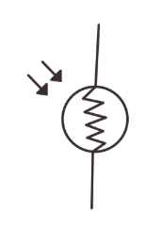
Photocell
Photocells are light dependent resistors. They are commonly used sensors for detecting if there is direct light present. Sometimes called photoresistors.
Circuit schematic symbol
Source: Sparkfun

Slide 8
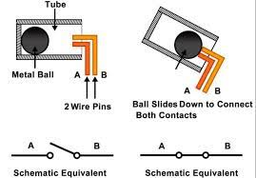
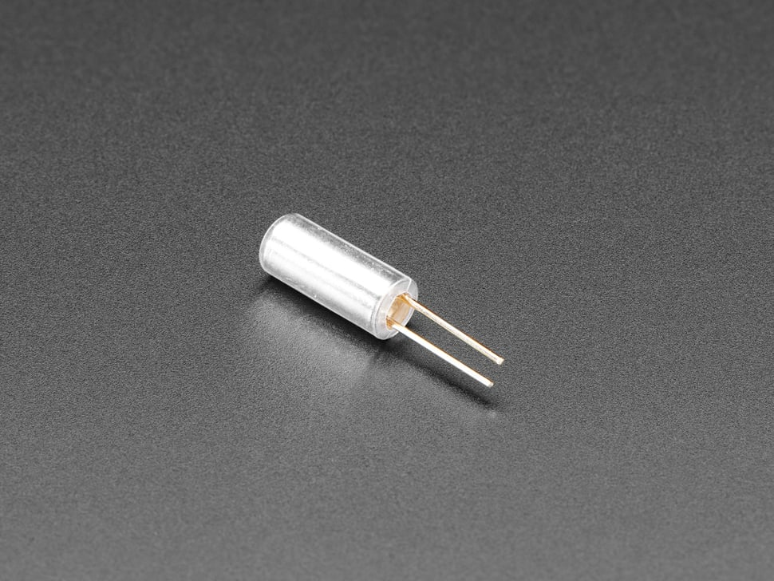
Tilt Switch
Tilt switches are switches that will open or close depending on the angle they are tilted.
Sources: Adafruit, Jack McTasney EE-1100 TA 2024

Slide 9
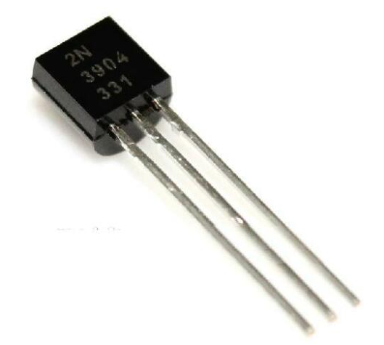
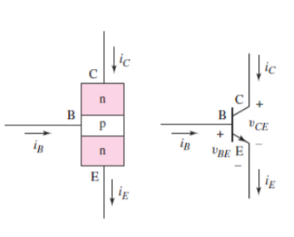
NPN Transistors
Transistors are devices made of semiconductors that are commonly used as amplifiers and switches. Transistors are used commonly in integrated circuits and can be found as a key building block in almost all electronic devices. NPN means Negative Positive Negative in reference to the charge if the different regions in the transistor.
C
E
B
Circuit Schematic Diagram and labels
Sources: Microelectronics Circuit Analysis and Design by Donald Neaman, Ebay

Slide 10
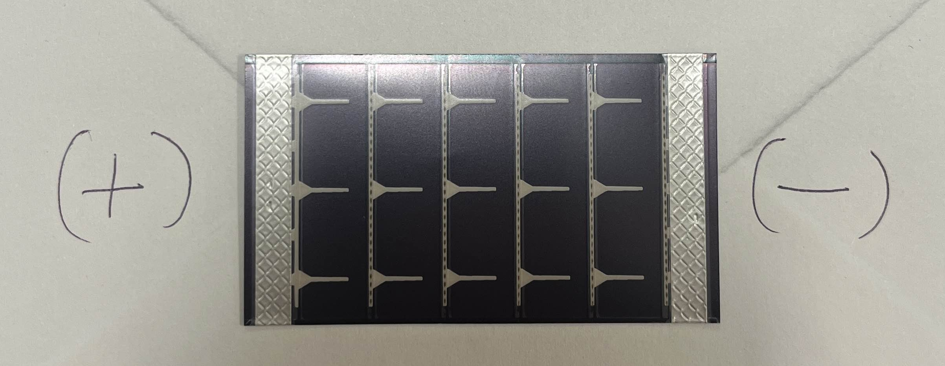
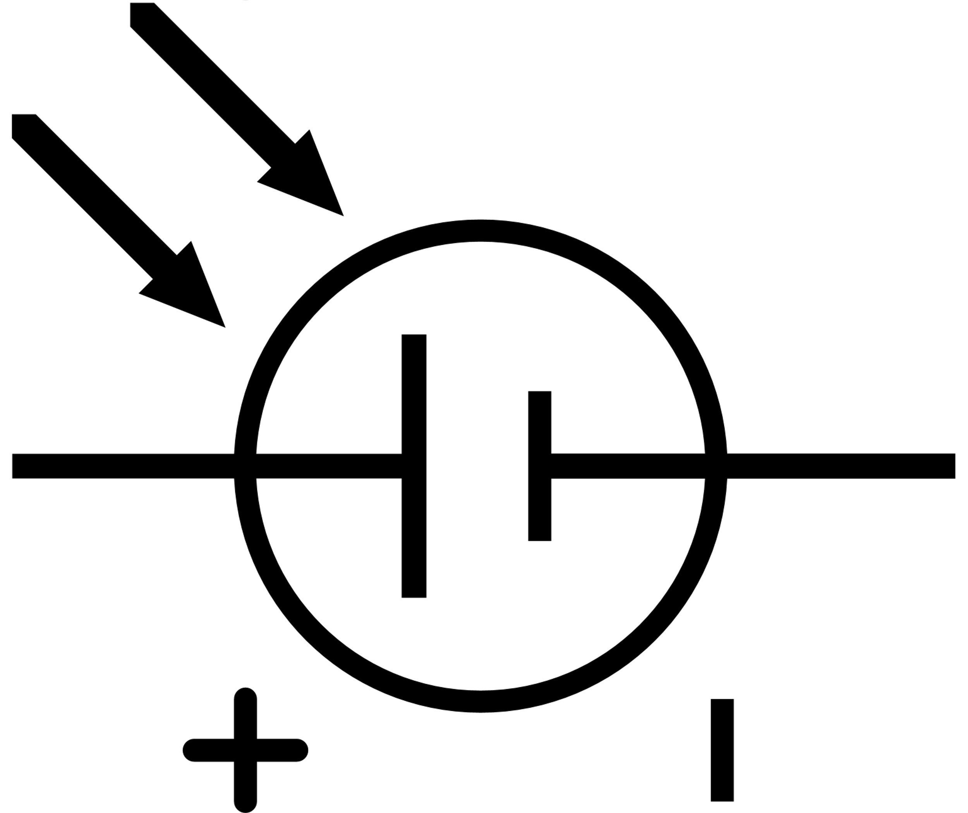
Solar Cells
Solar cells act like voltage sources (like power supplies) BUT vary their voltage with light applied to the top of the cell! On their own the output current is weak (~1-2mA), but in parallel you can increase the total output to something more suitable to your needs!
Sources: Circuit Lab, Jack McTasney Spring 2025 TA

Slide 11
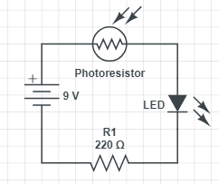
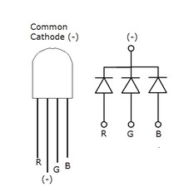
Activity 1: Intro to Photoresistors
Sources: Circuit Lab, Jack McTasney Spring 2025 TA

Slide 12
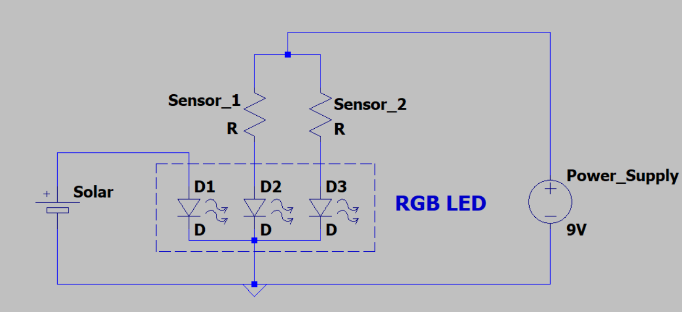
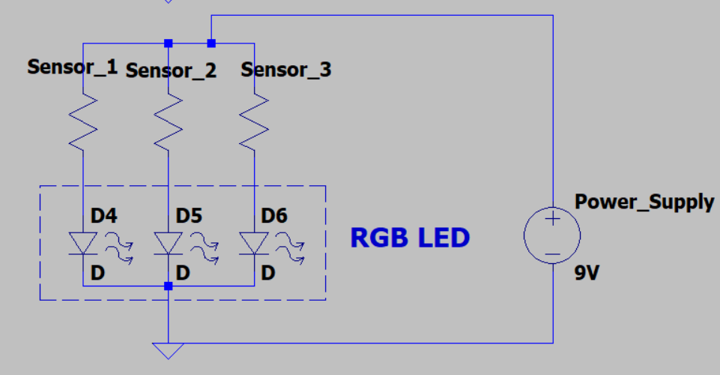
Activity 2: RGB LED Circuit (Pick one of these!)
Sources: LTSpice, Jack McTasney Spring 2025 TA

Slide 13
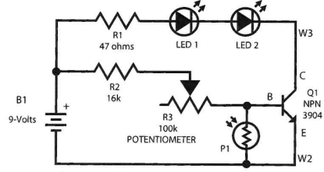
Activity 3: Automatic Night Light
Play with the potentiometer, see what happens when you cover the photoresistor!!
Sources: tron.ix TECH-ED Series “Fundamental Concepts” Version 6.4.4

